Slide 1
Image enhancement
DPED vs WESPE

Slide 2
Goals
Improve image quality in a way that allows for better semantic segmentation
Solutions
Classic image processing techniques
Neural style transfer
Supervised deep image inhancement (DPED)
Weakly supervised deep image inhancement (WESPE)
Common problems
Pixel perfect datasets for supervised learning (DPED)
Creation of worse images domain from good images domain (DPED and neural style transfer)
Generalisation (DPED)
Worse performance (WESPE)
NOTE: Depending on the data we have and the scope of the project we can deal with different concerns

Slide 3
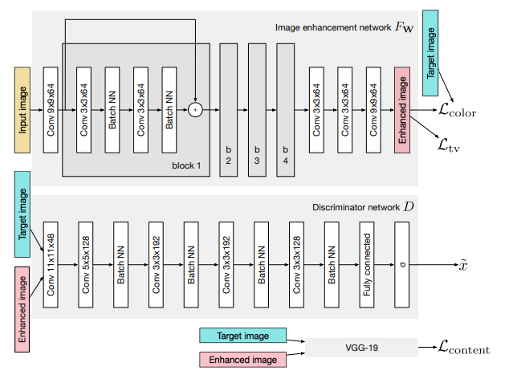
DPED
Images from iPhone, Blackberry, Sony phone cameras (X)
Images of the same scenery from Canon DSLR camera (Y)
Use SIFT to match patches from X and Y on a pixel level
DPED architecture:

Slide 4
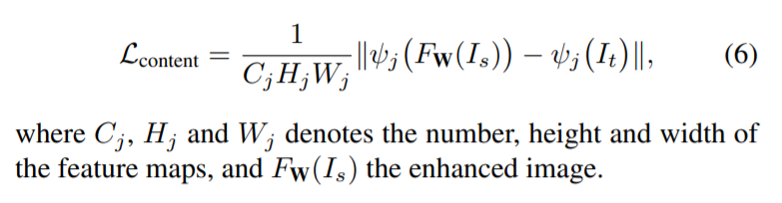
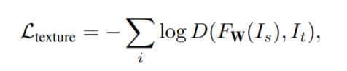
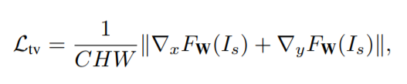
DPED losses
Content loss
Between enhanced imaged from generator and target image
Based on VGG19 ReLu activations encompassing content
Color loss
Euclidian distance between blurred target image and blurred enhanced image
Blur assures elimination of texture and content comparison
Encompasses difference in brightness, contrast and major colors
Texture loss
Learned in adversarial fashion
Discriminator trained to minimise cross entropy between fake and true images
Total variation loss
Enforces spatial smoothness of produces images
Low weighting in final total loss function so sole purpose is to reduce noise

Slide 5
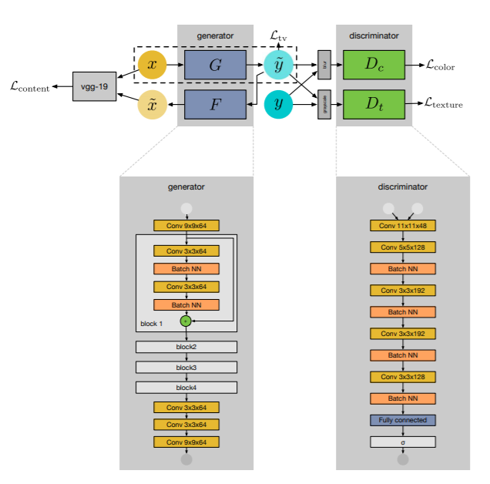
WESPE
Images from lower quality cameras
Images from DSLR cameras
Images need not be of the same scenery
WESPE architecture:
Same generator and discriminator
architecture

Slide 6
WESPE losses
Content consistency loss (main difference w.r.t DPED)
Instead of comparing enhanced images (like DPED), we take the enhanced image and pass it through an inverse generator to map features back to "bad quality" domain
This allows unpaired data to be used
Adversarial color loss
Uses discriminator to differentiate between blurred enhanced images and blurred "good quality" domain pictures
Encompasses the same details (contrast brightness, ..) as DPED color loss but computed in adversarial fashion
Adversarial texture loss
Same as DPED
TV loss
Same as DPED

Slide 7
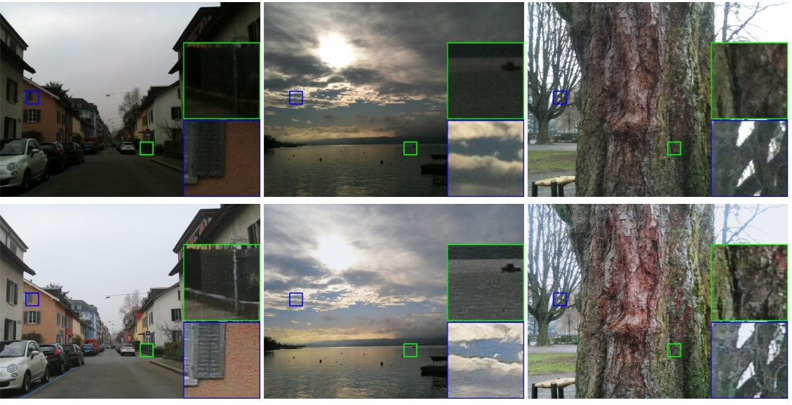
WESPE, DPED interactive results
http://people.ee.ethz.ch/~ihnatova/wespe.html
'Limitations' that might be beneficial to us
Color deviations (pure color shifts we don’t care about but it may allow us to play with brighness correction so we have a more uniform distribution of intesities)
Contrast should not be a problem to us (the more we can emphasize the difference between walls and cells the better)

Slide 8
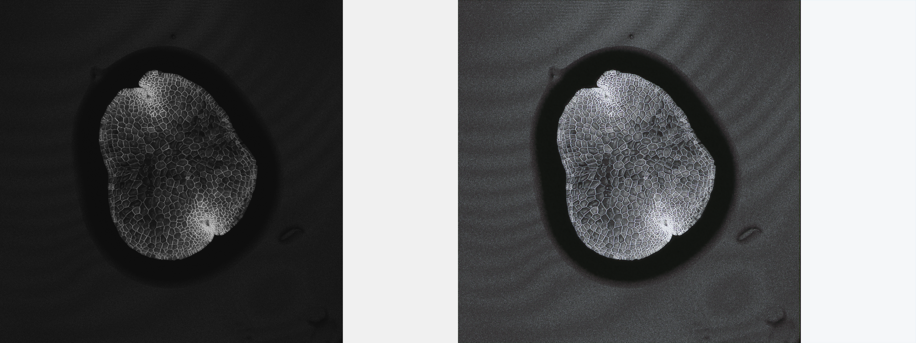
Preliminary results

Slide 9
Preliminary results
Ran on DPED using their trained iPhone model
Took 1024 x 1024 image, patched it with white space to the right to keep scaling as close as possible to the original image, then upscaled (paint) to 1538 x 2048 (model constraint)
Seemingly good results with
DPED instead of WESPE
Trained on natural images, not biological data
Trained on RGB pictures with the intent to retain color accuracy
Trained on specific image size
Addons
More optimistic
Add a loss that quantifies how well an enhanced image would perform in a segmentation task
Adjust current losses to fit our needs
Less optimistic
Add image segmentation for end to end training

